Slide 1


Testing MEMS based Accelerometers
Prepared by:
Tasmin Khan
Tanvir Hossain
Hasib Ur Rashid
Anindya Alam

Slide 2
Sensors
Boards
ICM20948
ADXL 355
ADXL 345
ESP32C6
ESP32S3
Raspberry pi

Slide 3
Why use these two boards?
ESP32C6: 8MB Flash, 320 kB SRAM
ESP32S3: 8MB Flash, 512 kB SRAM These two offer good flash memory for our purpose.

Slide 4
Libraries used
ICM_20948 by Sparkfun : cpp file 72 KB, h file 13 kb
ADXL_345_WE by Wolfgang Ewald : cpp file 21 KB, h file 10 kb
PL ADXL_355 by Plasmapper : cpp file 22 KB, h file 14 kb
Note: Not the whole header or cpp file is loaded on the microcontroller but only the compiled binary part , this is just to give an approximation of required library sizes.

Slide 5
Data format
Integer: Remapped Sensor (uG)
Data Displayed (mG)
Calibrating limits and raw data instances are in float (unit - absolute)

Slide 6
Initial values for ICM 20948 on esp32c6 (No Calibration)
Accel X: -118.164 Y: -13.184 Z: -994.629
Gyro X: -0.779 Y: -3.183 Z: 0.015
Mag X: 8.700 Y: 35.550 Z: -113.700
Accel X: -113.770 Y: -9.766 Z: -1005.371
Gyro X: 1.931 Y: -1.153 Z: 1.107
Mag X: 9.300 Y: 36.450 Z: -113.250
Accel X: -130.859 Y: -1.953 Z: -1000.000
Gyro X: -2.130 Y: 1.351 Z: 2.176
Mag X: 10.200 Y: 37.350 Z: -112.650

Slide 7
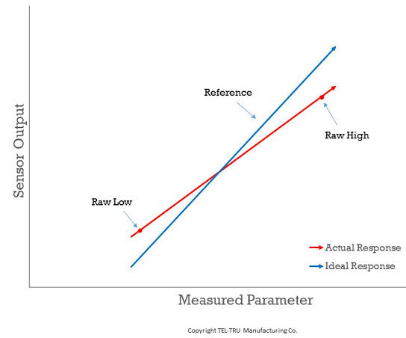
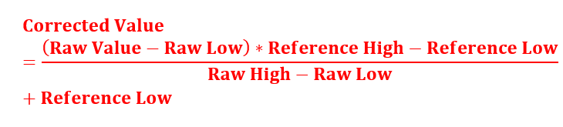
Two point calibration

Slide 8
Value acquisition in six orientations
Starting the calibration
Orientation 1: Rotate the board and press the button to start.
Button pressed, reading data in 3 seconds.
Orientation 1: data collection complete.
Orientation 2: Rotate the board and press the button to start.
Button pressed, reading data in 3 seconds.
Orientation 2: data collection complete.
Orientation 3: Rotate the board and press the button to start.
Button pressed, reading data in 3 seconds.
Orientation 3: data collection complete.
… … …
The calibration is done
Calibration Successful

Slide 9
Calibration Limits for ICM 20948
ICM20948 Calibration Limits:
Calibration Limits:
X-axis Min: -1017.09 Max: 1006.84
Y-axis Min: -1039.55 Max: 985.84
Z-axis Min: -1020.51 Max: 1016.60

Slide 10
Calibration Limits for ADXL355
ADXL355 Calibration Limits:
Calibration Limits:
X-axis Min: -1.02g Max: 1.0g
Y-axis Min: -1.02g Max: 1.01g
Z-axis Min: -1.03g Max: 1.0g

Slide 11
Calibration Limits for ADXL345
ADXL345 Calibration Limits:
Calibration Limits:
X-axis Min: -262 Max: 257
Y-axis Min: -259 Max: 257
Z-axis Min: -257 Max: 250

Slide 12
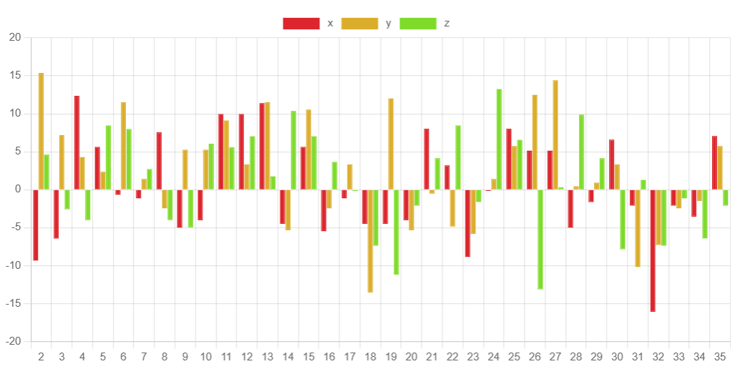
Sensor: ICM20948 9DOF
Board: ESP32C6
Unit: milliG
Calibrated values
For three axes x, y, z
Under no stimulation

Slide 13
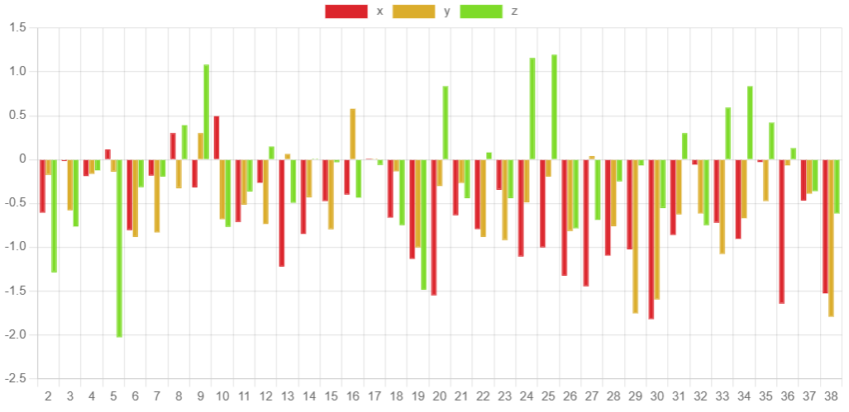
Sensor: ADXL355
Board: ESP32C6
Unit: milliG
Calibrated values
For three axes x, y, z
Under no stimulation

Slide 14
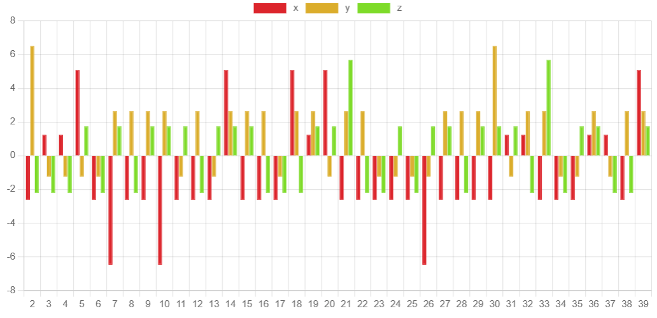
Sensor: ADXL345
Board: ESP32C6
Unit: milliG
Calibrated values
For three axes x, y, z
Under no stimulation

Slide 15
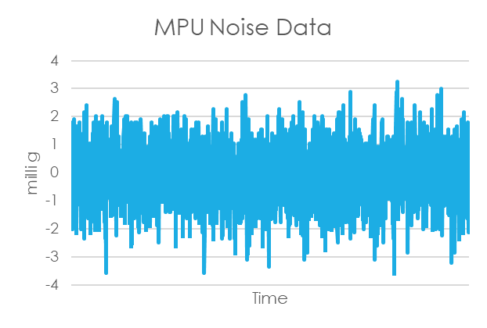
Sensor: MPU6050 10DOF
Board: ESP32
Unit: milliG
Calibrated values
For three axes x, y, z
Under no stimulation
*This data is from our previous experiment

Slide 16
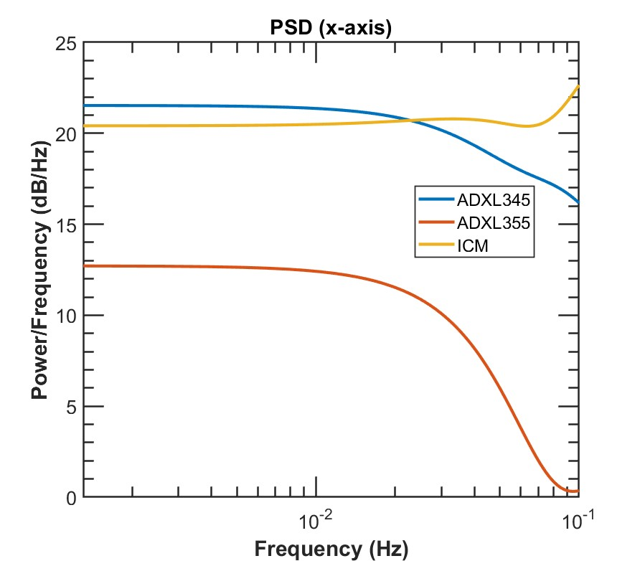
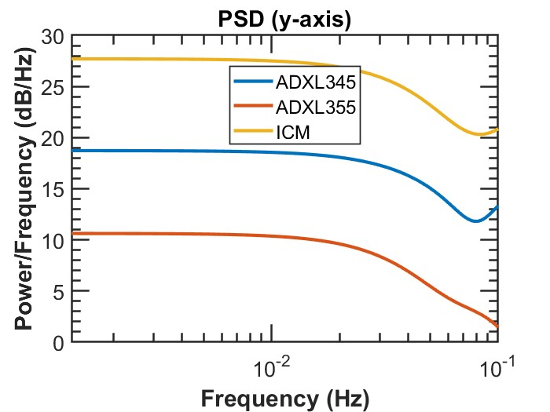

Noise Power Spectral Density Analysis

Slide 17
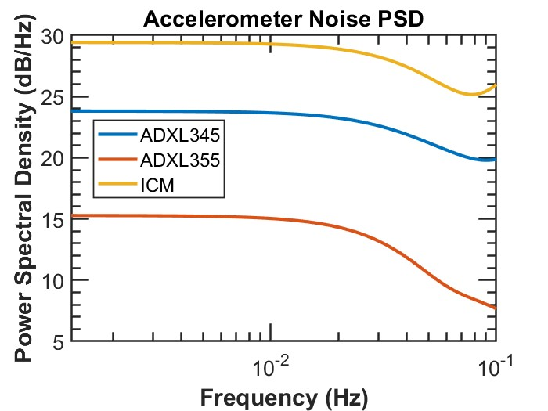
Noise Power Spectral Density Analysis

Slide 18
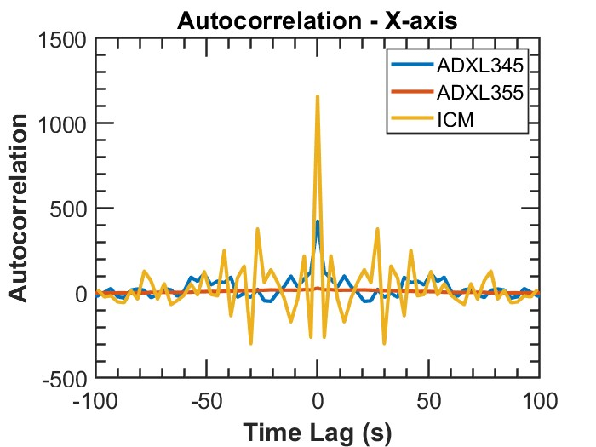
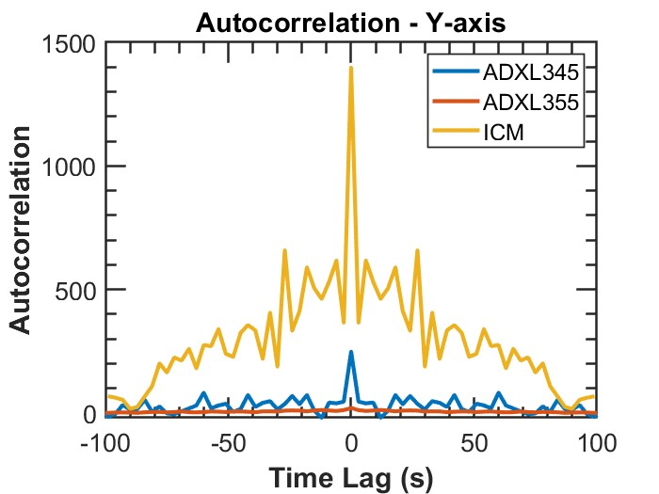
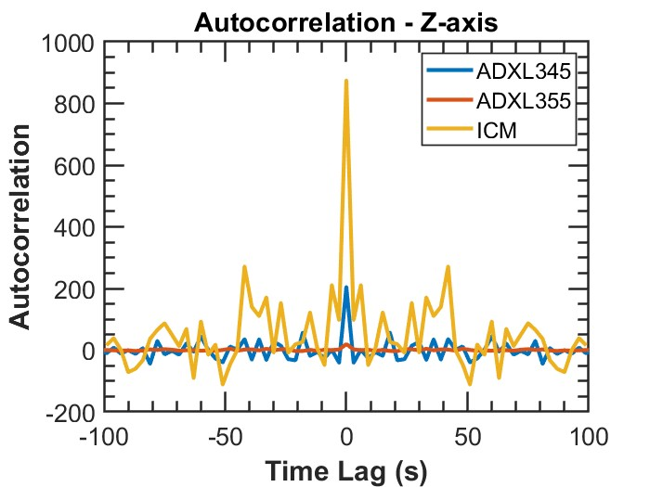
Autocorrelation of Noise Data

Slide 19
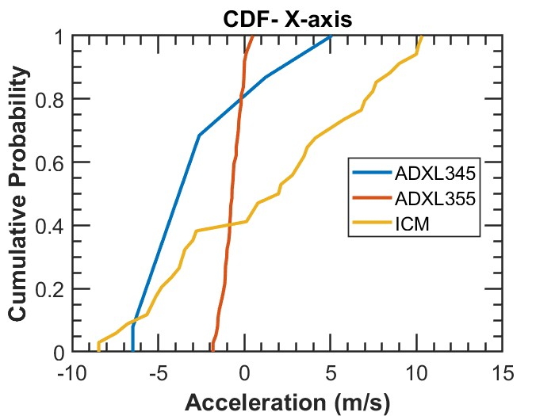
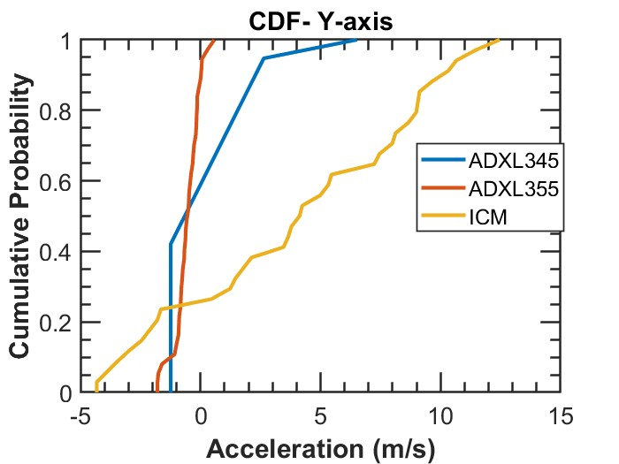
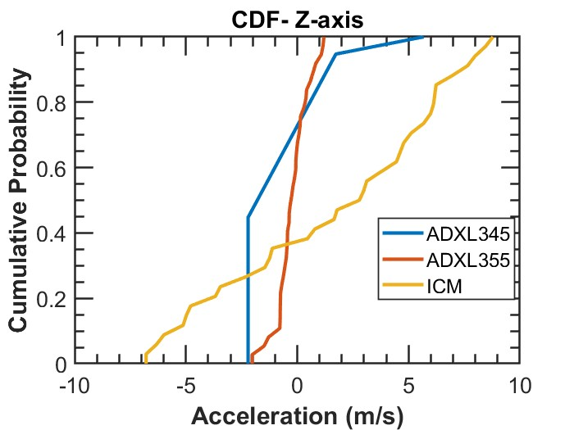
Cumulative Distribution of Noise

Slide 20
Conclusion from no stimulation noise
The sensor noise performance in best to worst order: ADXL 355, ADXL 345, ICM20948 – 9DOF.
The data can vary slightly due to being tested at different times of the day for individual sensors. For example, Night-time tends to have less noise than daytime.

Slide 21
Next challenges
To runs stimulated tests on the three sensors under known stimulation, Requirements for that is:
At least 3 SD cards to store data
A system to provide independent power supply
Casing and/or PCB to hold the components where the wires will not get loose during experiment

Slide 22
Question
We initially selected micro controllers based on maximum flash memory space. Now what kind of tests should be run or benchmarks to be checked to determine which micro controller works best for a particular sensor given the flash memory is same for both esp boards?

